Slide 1
Common Gateway Interface
(CGI)

Slide 2
What is CGI?
CGI (Common Gateway Interface) is a standard protocol that allows a web server to interact with external content-generating programs, which are often referred to as CGI scripts. These scripts can be written in various programming languages, such as Perl, Python, or PHP, and are executed on the server to generate dynamic web content.

Slide 3
How CGI Works
Request: A client (e.g., a web browser) sends a request to the server.
CGI Script Execution: The server executes the CGI script, passing any necessary data from the request.
Response: The CGI script processes the request and generates a response, which is then sent back to the client.

Slide 4
Advantages of CGI
Flexibility: CGI allows for the creation of dynamic web pages that can change based on user input or other factors.
Versatility: CGI scripts can be written in various programming languages, offering developers a wide range of tools and libraries to work with.

Slide 5
Understanding Environment Variables in CGI
Environment variables are a set of dynamic named values that can affect the way running processes behave on a computer. In the context of CGI, environment variables provide the CGI script with information about the client request, the server, and the execution environment.

Slide 6
Key CGI Environment Variables
QUERY_STRING: Contains the query string from the URL.
REQUEST_METHOD: Indicates the HTTP method used (e.g., GET, POST).
CONTENT_TYPE: The MIME type of the data sent by the client.
REMOTE_ADDR: The IP address of the client making the request.

Slide 7
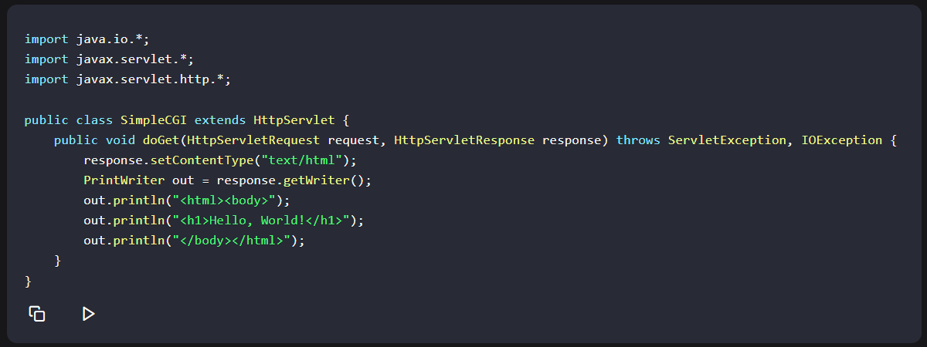
How CGI Works in Java
In Java, CGI scripts are typically written as servlets or JavaServer Pages (JSP). These scripts run on the server and generate HTML or other types of content in response to HTTP requests. The server then sends this content back to the client's browser.

Slide 8
Disadvantages and Limitations of CGI
While CGI has been instrumental in the early days of web development, it has several disadvantages and limitations, especially when used in Java applications:
Performance: CGI scripts are executed for each request, which can lead to performance issues for high-traffic websites.

Slide 9
Statelessness: CGI scripts do not maintain state between requests, making it difficult to implement complex web applications.
Security Risks: CGI scripts can be vulnerable to security attacks, such as buffer overflow and cross-site scripting (XSS).
Complexity: Managing CGI scripts can be complex, especially in large-scale applications.

Slide 11
Quiz!!
What does cgi stands for.
2-3. Identify 2 programming languages that a cgi script can be written in
4. The CGI script processes the request and generates a , which is then sent back to the client.
5-6 what are the 2 advantages of CGI.
are a set of dynamic named values that can affect the way running processes behave on a computer.
8-9-10. give 3 disadvantage and limitations of CGI.

Slide 12
Common gateway interface
Pearl
Python php
Response
Flexibility
Versatility
Environment variables
Performance
Statelessness
Security Risks
Complexity

